Slide 1

Welcome to Mrs. Logan’s
First Grade!
Open House
2015-2016

Slide 2

Our Schedule
8:40 Announcements/Pledge/Agenda
8:45-11:00 Literacy/Social Studies
11:12-11:42 Lunch
11:42-12:50 Math
12:50-1:20 Science
1:20-1:30 Snack
1:30-2:10 Specials*
2:10-2:40 Recess/Media**
2:40 Read Aloud
2:55 Announcements/Dismissal
*Specials Rotation:
1. P.E. 2. Science 3. Spanish 4. Art 5. Music
**Media: P.E. days at 2:15-2:45

Slide 3

Classroom Procedures
Daily homework and behavior will be recorded in the students’ agenda. Please sign the agenda every night.
Homework will be given every night. Please check your child's homework folder for important information.
Fluency Folders will be sent home every night.
Students must read an AR book every day and take at least two AR tests per week. AR will be part of your child’s grade.
Students must complete 30 minutes of reading and 30 minutes of math using the I-Ready program per week.
Students must have a book to read in their backpack at all times.
Students may bring a small healthy snack.
It gets really cold in the classroom. Keep a sweater in your child’s backpack.

Slide 4




Behavior Plan
All Students begin on green “Ready to Learn.”
Break a rule:1. Yellow= warning no dot on treat chart.
2. Orange=lose privileges and behavior reflection note
3. Red=above consequences and Jupitergrades behavior alert.
Rewards for good behavior:
10 dots=Treasure chest!!
High Five is awarded quarterly for exemplary behavior
***less than 3 color changes and consistent completion of homework

Slide 5

Electronic Devices
Electronic devices are allowed at school.
The school is not responsible for lost or damaged devices.
Devices are not permitted at lunch.
Students may not take pictures or videos at school.

Slide 6

Lunch
All lunch money must be placed in an envelope and labeled with your child’s first/last name and lunch number. Lunch money will not be accepted if it is not in an envelope labeled with your child’s name.
Sign up for My Payments Plus and you can load your child’s lunch account from your computer.
Get the App and pay on your smart phone.
https://www.mypaymentsplus.com

Slide 7
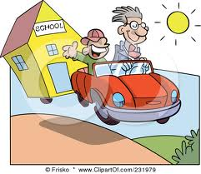
Arrival and dismissal
Students cannot be dropped off at school before 8:15 or picked up after 3:30. You will receive a Before Care charge for early drop off and an After Care charge for late pick up. No early dismissal after 2:30. Please stay in your car when picking up your child. If your child is designated a walker he or she will not be supervised.
If your child is going to change how he/she is going home, you must call the front office, E-mail or put it in writing. I would suggest a phone call and in writing to avoid confusion.

Slide 8
School Supplies
You may drop off your child’s school supplies today.
Students need pencils, crayons, scissors and glue sticks everyday!
Science Lab
1 composition notebook
1 folder
1 large old t-shirt
All items must be labeled with your child’s name and placed in a large Ziploc bag.

Slide 9

Service Hours
Each family is required to complete 30 service hours. Hours can be done in the class or out of the classroom. Donations are for items requested only; ½ hour volunteer time will be given per donation. Maximum of 10 hours allowed for donations.
I will send alerts for volunteer opportunities via Jupitergrades, Bloomz and/or the class website.
It is your responsibility to track, complete and turn in your volunteer form. Keep it in a safe place to ensure you receive all of your hours!

Slide 10

Absences/Tardies
Please call the school within 48 hours of your child’s absence. Please refer to the school wide attendance policy to determine if an absence is considered excused. If a child is tardy the parent must sign them in at the front office.
The Literacy Block begins promptly at 8:45 please ensure your child is at school on time.

Slide 11
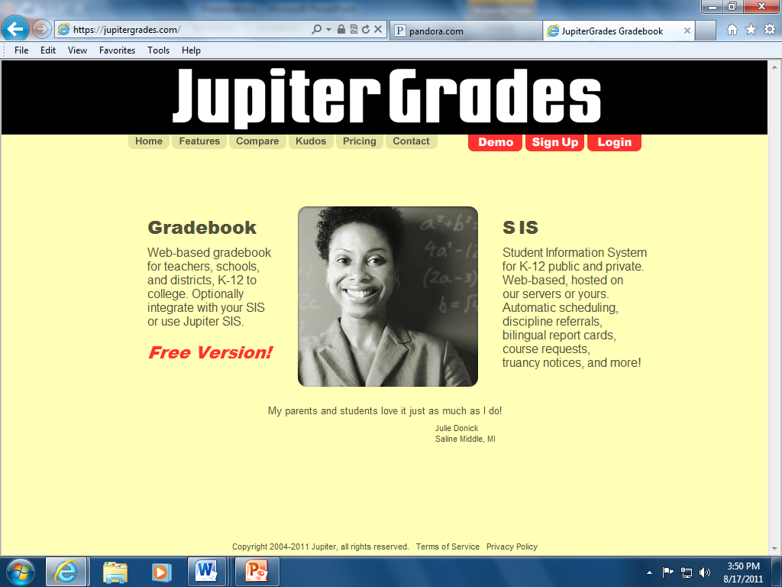
Jupitergrades
All grades, Interim Reports and communication will be through www.Jupitergrades.com.
It is the same account as last year.
If you are new to the school, you will receive a paper to set up your account.

Slide 12
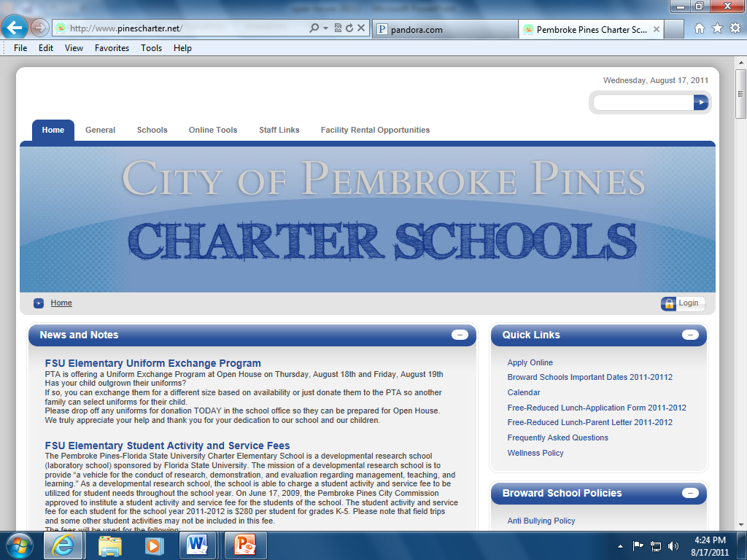

School Website
Our school website is…
www.pinescharter.net
Please visit for updates, volunteer information, school programs, lunch menus and links to teacher E-mails.
Before Care and After Care registration packets are found here too.

Slide 13

Our Class Website
http://426166635649551822.weebly.com/ or you can access the website via http://pinescharter.net/Schools/EastCampusK5/EastElementaryStaff.aspx. Type Logan in the search box and the class website link can be found there.
The class website provides information on weekly skills, upcoming events and the weekly spelling words.

Slide 14
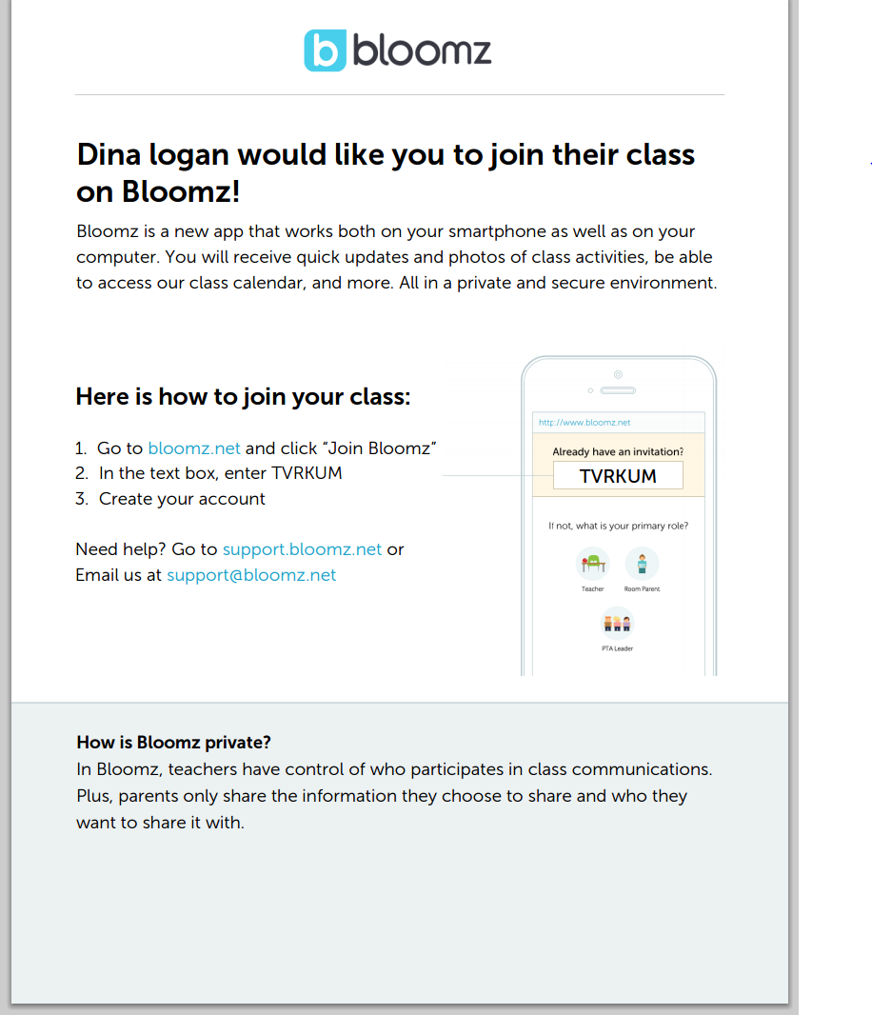
Join Bloomz for Class Updates!

Slide 15

Join PTA

Slide 16
Before You Leave Today…
Let me know how your child is getting home the first day of school.
Alert me if your child has any allergies or food restrictions.
Turn in your volunteer form to receive volunteer hours for attendance today.
Take a car rider hanger and fill out your child’s first and last name.
Visit the cafeteria to buy a seat sack, join PTA, place money in your child’s lunch account, find school bus information, register for before or after care and purchase a spirit shirt.
Take a wish list item and receive one ½ volunteer hour per donation.
If you purchased a supply kit please sign for it and take it today.

Slide 17


See you on Monday!

